Slide 1

Automotive Technology:
A Systems Approach, 8e
Chapter 18: Starting and Motor Systems
Rob Thompson and Jack Erjavec, Automotive Technology: A Systems Approach, 8th Edition. © 2025 Cengage. All Rights Reserved. May not be scanned, copied or duplicated, or posted to a publicly accessible website, in whole or in part.

Slide 2
Chapter Objectives
18.01 Describe the basics of electromagnetism.
18.02 Explain the purpose of the starting system.
18.03 Describe the operation of electric starting motors.
18.04 Describe the purpose and major components of the starting and starter control circuits.
18.05 Inspect and test starter relays and solenoids and the switches, connectors, and wires of starter control circuits.
18.06 Perform starter circuit voltage drop tests and the starter current draw test.

Slide 3
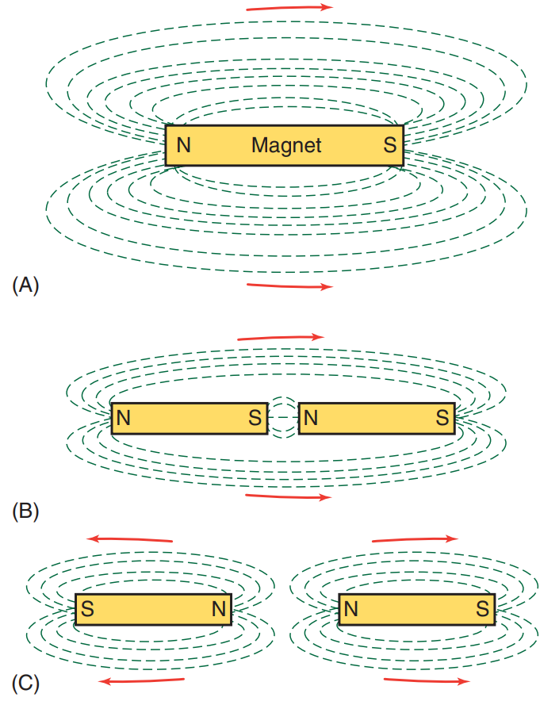
Basics of Electromagnetism (1 of 4)
18.01 Describe the basics of electromagnetism.
A substance is said to be a magnet if it has the property of magnetism—the ability to attract such substances as iron, steel, nickel, or cobalt.
A magnet has two points of maximum attraction, one at each end of the magnet.
These points are designated the north pole and the south pole.
When two magnets are brought together, opposite poles attract, while similar poles repel each other.
A magnetic field, called a flux field, exists around every magnet. The field consists of lines along which the magnetic force acts.
These lines emerge from the north pole and enter the south pole, returning to the north pole through the magnet itself.
All lines of force leave the magnet at right angles to the magnet. None of the lines cross each other and all are complete.

Slide 4
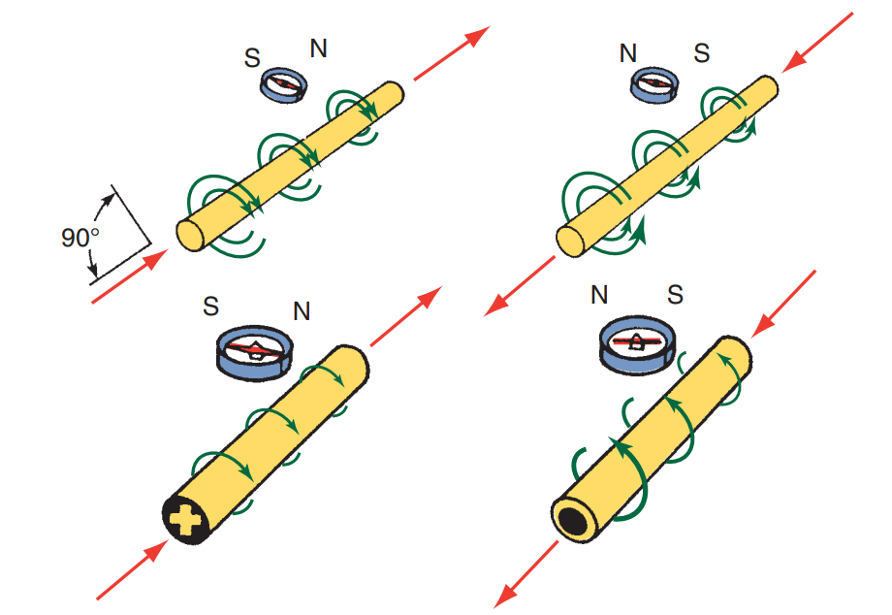
Basics of Electromagnetism (2 of 4)
Magnets can occur naturally in the form of a mineral called magnetite.
Artificial magnets can be made by inserting a bar of magnetic material inside a coil of insulated wire and passing current through the coil.
Another way of creating a magnet is by stroking the magnetic material with a bar magnet.
Both methods force the randomly arranged molecules of the magnetic material to align themselves along north and south poles.
Temporary magnets are usually made of soft iron. They are easy to magnetize but quickly lose their magnetism when the magnetizing force is removed.
Permanent magnets are difficult to magnetize.

Slide 5
Basics of Electromagnetism (3 of 4)
Just as current can only flow through a complete circuit, the lines of flux created by a magnet can only occupy a closed magnetic circuit.
The resistance that a material offers to the passage of magnetic flux lines is reluctance.
Magnetic reluctance can be compared to electrical resistance.
When a coil of current-carrying wire is wound around an iron core, it becomes an electromagnet.
The strength of an electromagnet’s magnetic field is directly proportional to the number of turns of wire and the current flowing through them.
The number of magnetic lines is proportional to the ampere-turns divided by the reluctance.
  The magnetic polarity of the coil depends on the direction of current flow through the loop.
  Field strength increases if current through the coil increases.
  Field strength increases if the number of coil turns increases.
  If reluctance increases, field strength decreases.

Slide 6
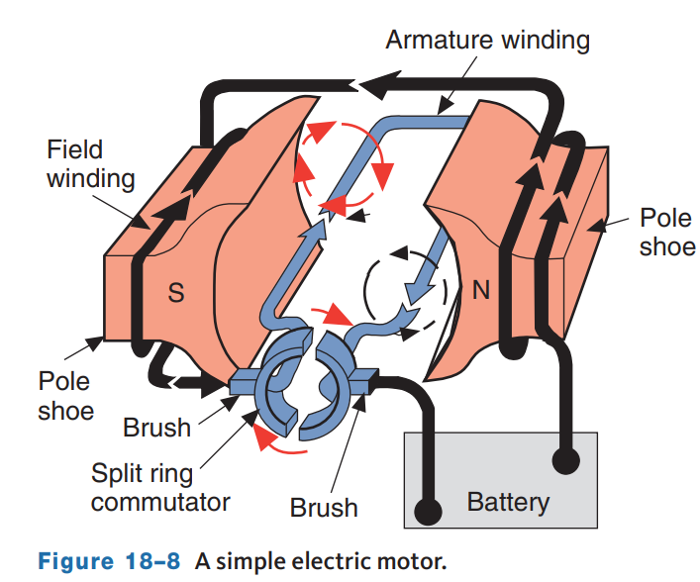
Basics of Electromagnetism (4 of 4)
An electric motor converts electric energy into mechanical energy.
By taking two bar magnets and placing them end-to-end with each other, they will push away from each other if the ends have the same polarity.
If the ends have the opposite polarity, they will move toward each other and form one magnet.
If we put a pivot through the center of one of the magnets to allow it to spin and moved the other magnet toward it, the first magnet will either rotate away from the second or move toward it.
This is basically how a motor works and will cause the motor to rotate one half turn.
By changing the polarity of the second magnet, we get another half turn and so on, switching back and forth.

Slide 7
Starting Motors (1 of 4)
18.02 Explain the purpose of the starting system.
The starting motor is a special type of electric motor designed to operate under great electrical loads and to produce great amounts of torque for short periods.
The starter motor consists of a housing, field coils (windings), an armature, a commutator with brushes, and end frames.
The starter housing or starter frame encloses the internal parts and protects them from damage, moisture, and foreign materials.
The housing also supports the field coils.
The field coils and their pole shoes are securely attached to the inside of the housing.
The field coils are insulated from the housing but are connected to a terminal that protrudes through the outer surface of the housing which connects to the solenoid.
The coils are wound around the pole shoes in opposite directions to create opposing magnetic fields.
The armature is the rotating part of a starter. It is located between the starter drive and commutator end frames and is enclosed by the field windings.

Slide 8
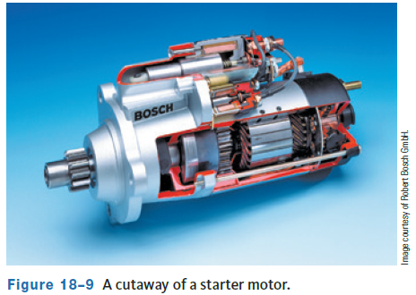
Starting Motors (2 of 4)
18.03 Describe the operation of electric starting motors.
When the armature windings are placed inside the field windings, part of the armature coil is pushed in one direction as the field in the windings which causes the armature to begin to rotate.
As the armature moves, the contact between a brush and commutator segment is broken and the brush contacts a new segment.
This causes a reverse in the polarity of the magnetic field around the armature.
The new opposition of magnetic fields causes the armature to rotate more.
This process continues and the armature continues to rotate until current stops flowing to the armature.

Slide 9
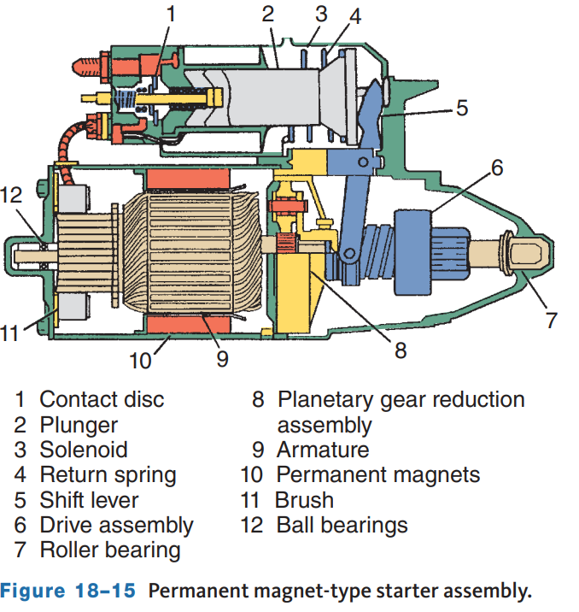
Starting Motors (3 of 4)
Many starter and accessory motors use permanent magnets instead of electromagnets as field coils.
Electrically, this type of motor is simpler because it does not require current for the field coils.
Current is delivered directly to the armature through the commutator and brushes.
Except for no electromagnets in the fields, this functions exactly as the other motors.
Maintenance and testing procedures are the same as for other designs.
Notice the use of a planetary gear reduction assembly on the front of the armature.
This allows the armature to spin with increased torque, resulting in improved starter cold-cranking performance.

Slide 10
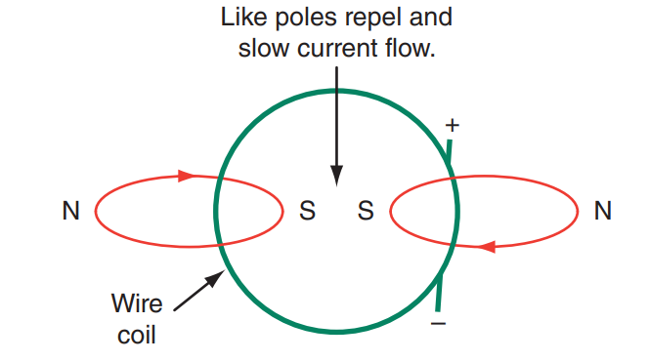
Starting Motors (4 of 4)
The slower the motor turns, the more current it will draw.
This is why a starter motor will draw large amounts of current when the engine is difficult to crank.
A motor needs more torque to crank a difficult-to-start engine.
The relationship between current draw and motor speed is explained by the principles of counter EMF (CEMF).
Electromotive force (EMF) is another name for voltage.
When the armature rotates within the field windings, conditions exist to induce a voltage in the armature.
Voltage is induced anytime a wire is passed through a magnetic field.

Slide 11
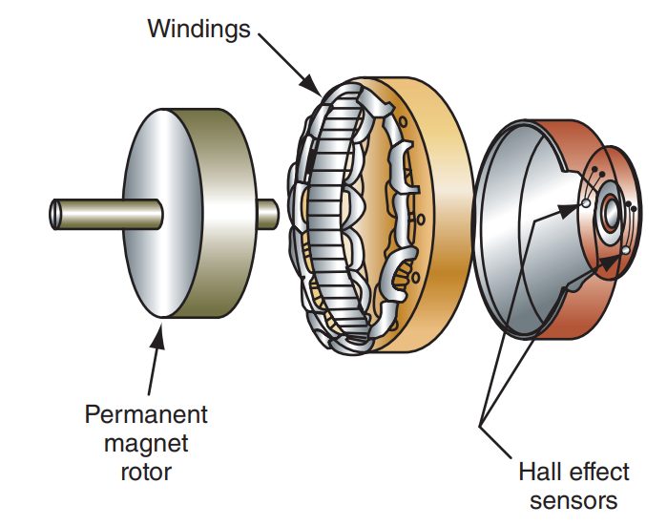
Brushless Motors
Brushless motors use a permanent magnet rotor and electromagnetic field windings.
This design eliminates the arcing at the contact area between the brushes and commutator, which extends the service life of the motor.
It also decreases EMI which can affect the operation of many electronic systems.
High-output brushless DC motors are used in some HEV-drive vehicles.
These motors operate through the control of the stator by an electronic circuit that switches current flow, as needed, to keep the rotor rotating.
The key to this is the use of a Hall-effect sensor that monitors the position of the rotor.

Slide 12
Discussion
An electric motor converts electric energy into mechanical energy, and a starter motor is a very common type of motor.
Have a class discussion on starter motor operation, describing the magnetic fields, current flow, and rotation of the motor armature.

Slide 13
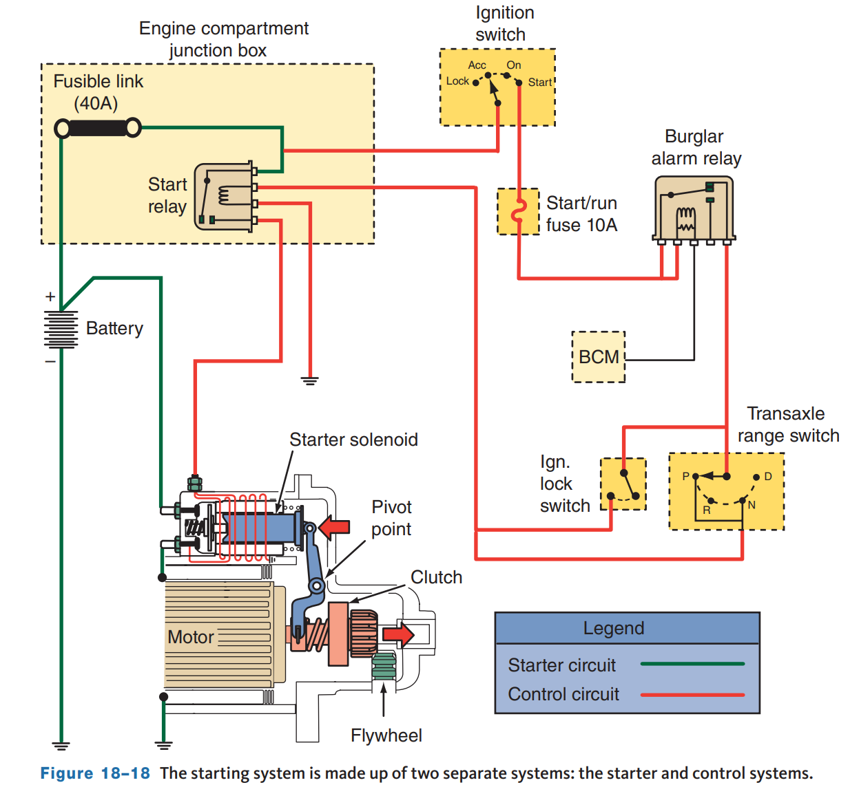
Starting System
The starting system is designed to turn or crank the engine until it can operate under its own power.
To do this, the starter motor is engaged to the engine’s flywheel. As it spins, it turns the engine’s crankshaft.
The battery cables are not connected to the switch. Rather, the system has two separate circuits.
The starter motor circuit carries the heavy current from the battery to the starter motor through a magnetic switch in a relay or solenoid.
The control circuit connects battery power at the ignition switch to the magnetic switch, which controls the high current to the starter motor.

Slide 14
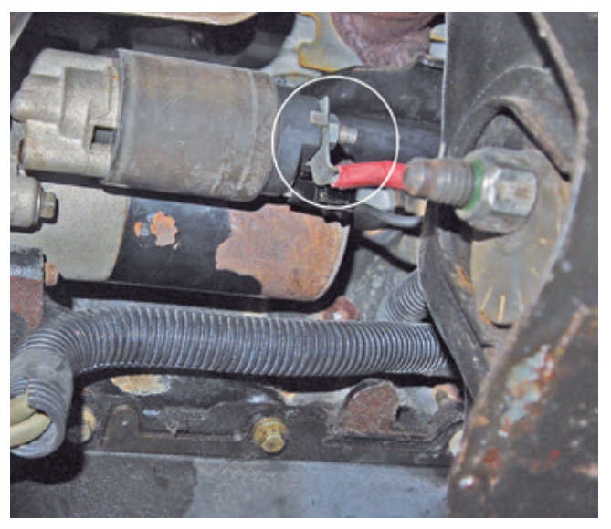
Starter Motor Circuit
18.04 Describe the purpose and major components of the starting and starter control circuits.
The starter motor circuit carries the high current flow within the system and supplies power for the actual engine cranking.
Components of the starter motor circuit are the battery, battery cables, magnetic switch or solenoid, and the starter motor.
The motor circuit requires two or more heavy-gauge cables. One of these cables connects between the battery’s negative terminal and the engine block or transmission case.
The other cable connects the battery’s positive terminal with the solenoid.

Slide 15
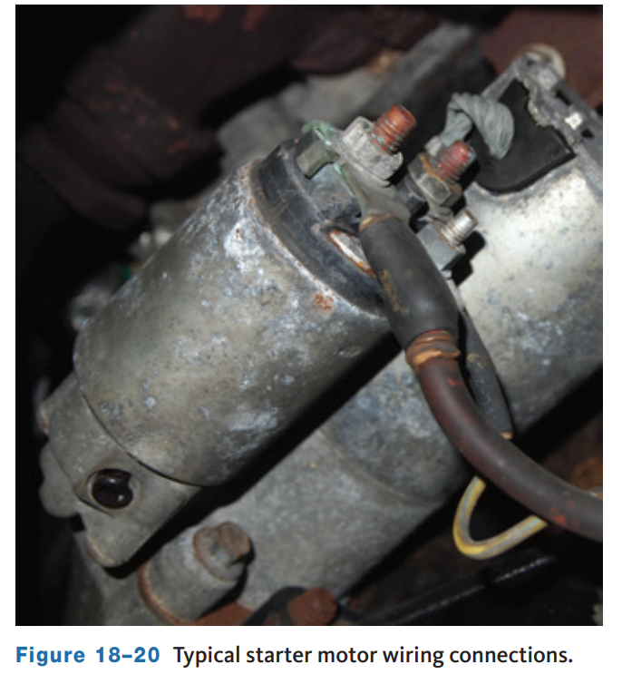
Magnetic Switches
A solenoid is an electromechanical device that uses the movement of a plunger to exert a pulling or holding force.
The solenoid is most commonly mounted directly on top of the starter motor.
In this type of starting system, the solenoid uses the electromagnetic field generated by its coil to perform two distinct jobs.
The first is to push the drive pinion of the starter motor into mesh with the engine’s flywheel.
The second job is to act as an electrical relay switch to energize the motor once the drive pinion is engaged. Once the contact points of the solenoid are closed, full battery current flows to the starter motor.
The solenoid assembly has two separate windings: a pull-in winding and a hold-in winding.

Slide 16
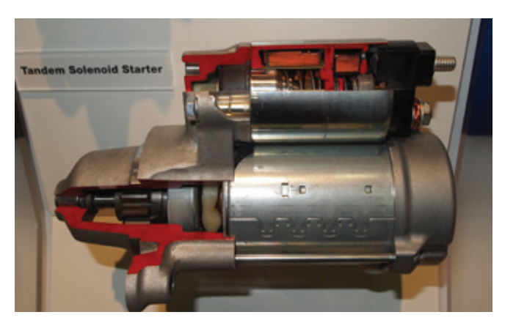
Auto Start-Stop Solenoid
In order to reduce fuel consumption, many late model engines are equipped with auto start-stop or idle-stop systems.
These systems shut the engine off when idling and very quickly restart it when the driver lifts off the brake pedal or presses the accelerator pedal.
To accomplish rapid restarts, which may include re-engaging the starter drive even before the engine stops spinning, a new type of solenoid is needed.
Tandem solenoid starters can operate the starter drive gear separately from spinning the armature.
This allows the system to engage the drive gear even with the engine spinning.
The armature can then be activated through the rear section of the solenoid to crank the engine.

Slide 17
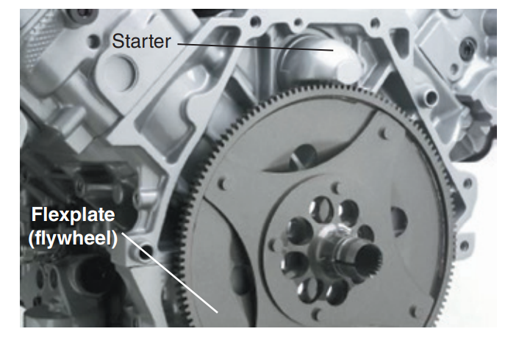
Starter Drives (1 of 2)
The starter drive is the device that couples the armature with the flywheel.
A pinion gear at one end of the armature meshes with the teeth on the outside of the flywheel.
The spinning armature then turns the flywheel. To prevent damage to the pinion gear or the ring gear on the flywheel, the pinion must mesh with the ring gear before the armature begins to spin.
To help ensure smooth engagement, the end of the pinion gear is tapered.
To disengage the pinion from the flywheel, the pinion is mounted to the armature via an overrunning clutch.

Slide 18
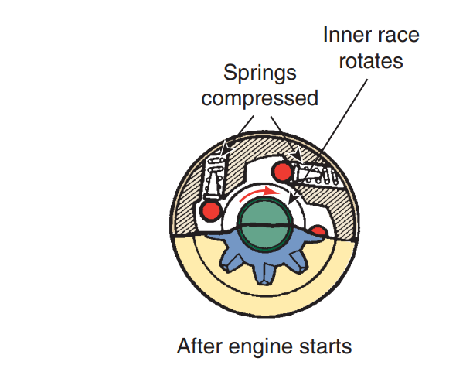
Starter Drives (2 of 2)
Once the engine starts, its speed increases.
If the starter motor remains connected to the engine through the flywheel, it spins at very high speeds, destroying the armature and other parts.
To prevent the armature from spinning at engine speed, an overrunning clutch is used.
The clutch housing is internally splined to the armature shaft. The drive pinion turns freely on the armature shaft within the clutch housing.
When the clutch housing is driven by the armature, the spring-loaded rollers are forced into the small ends of their tapered slots and wedged tightly against the pinion barrel.
This locks the pinion and clutch housing solidly together, permitting the pinion to turn the flywheel and, thus, crank the engine.

Slide 19
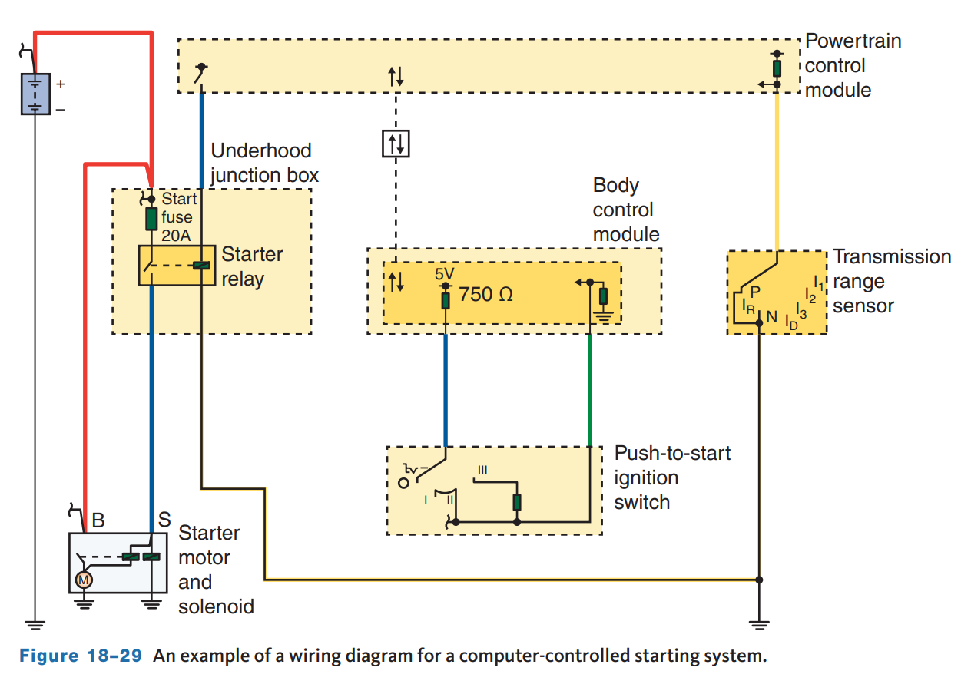
Control Circuit (1 of 3)
The control circuit allows a small amount of current to control the flow of a large amount of current in the starting circuit.
When the ignition switch is turned to the start position, a small amount of current flows through the coil of the magnetic switch, closing it and allowing full current to flow directly to the starter motor.
The ignition switch performs other jobs besides controlling the starting circuit.

Slide 20
Control Circuit (2 of 3)
On older vehicles, the entire circuit usually consists of an ignition switch connected through normal-gauge wire to the battery, safety switch, and a magnetic switch.
The ignition switch on newer vehicles does not directly control starter operation. Instead, the switch is an input for the onboard computer system.
When the key is turned to the crank position, the body control module (BCM) signals the powertrain control module (PCM) to activate the crank relay.
Current then passes through the crank relay to the starter solenoid which is common on vehicles with factory installed anti-theft systems.
A benefit of this system is the ability to add remote start capability from the vehicle’s key fob.
Many newer vehicles have eliminated the traditional key and ignition switch and instead use push button start and a smart key.
The start button is simply an input for the onboard computer system. The starter circuit is controlled based on inputs from the anti-theft, body, and powertrain computers.

Slide 21
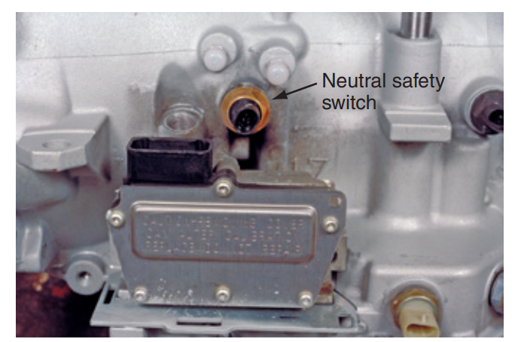
Control Circuit (3 of 3)
The starting safety switch, often called the neutral safety switch, is a normally open switch that prevents the starting system from operating when the transmission is in gear.
Starting safety switches can be located between the ignition switch and the relay or solenoid or the relay and ground.
In computer-controlled starting systems, the safety switch may be used as an input for the PCM and not be wired directly into the starter control circuit.
The switch contacts are wired in series with the control circuit so that no current can flow through the relay or solenoid unless the shift lever is in Neutral or Park.
The clutch start switch serves the same purpose as a Park/Neutral position switch.

Slide 22
Knowledge Check (1 of 2)
What is the purpose of a neutral safety switch?

Slide 23
Knowledge Check Answer (1 of 2)
Answer: The starting safety switch, often called the neutral safety switch, is a normally open switch that prevents the starting system from operating when the transmission is in gear.

Slide 24
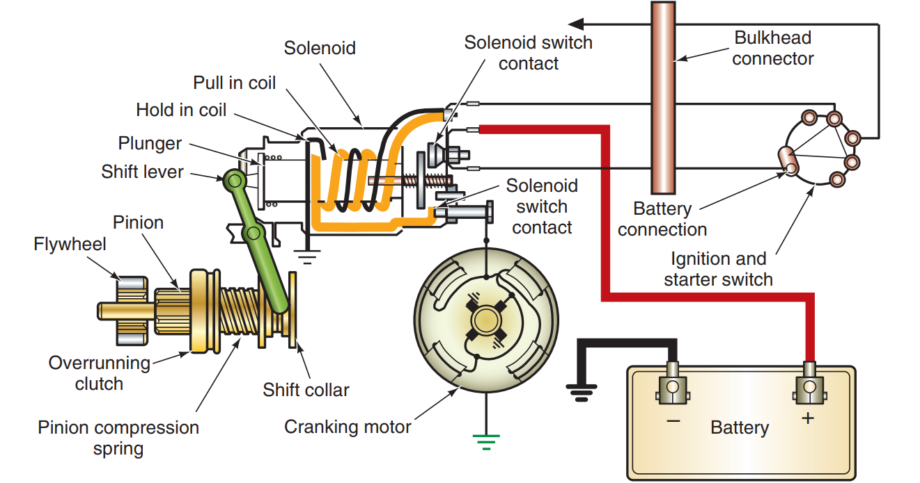
Starting System Testing (1 of 4)
18.05 Inspect and test starter relays and solenoids and the switches, connectors, and wires of starter control circuits.
The cranking output of the motor is affected by the condition and charge of the battery, the circuit’s wiring, and the engine’s cranking requirement.
Many of the problems associated with the starting system can be solved by troubleshooting the battery and its related components.
Check the wiring and cables for clean, tight connections.
Loose or dirty connections will cause excessive voltage drops.

Slide 25
Starting System Testing (2 of 4)
Safety Precautions:
  Almost all starting system tests must be performed while the starter motor is cranking the engine.
  However, the engine must not start and run during the test or the readings will be inaccurate.
  To prevent the engine from starting, the ignition switch can be bypassed with a remote starter switch that allows current to flow to the starting system but not to the rest of the electrical system.
  During testing, be sure the transmission is out of gear during cranking and the parking brake is set.

Slide 26
Starting System Testing (3 of 4)
Auto Start-Stop Concerns:
When attempting to diagnose a computerized starter circuit, first read the description and operation information for the vehicle.
Many customer complaints can be resolved just by understanding how the system operates and what can cause it to stop working.
For example, a system may disable auto start-stop for the following reasons:
  low ambient temperatures
  low battery temperature or low battery voltage
  high demand on the A/C system
  high engine coolant temperature
  defrost mode is selected
  certain DTCs are stored in the PCM. If a problem does exist, perform a vehicle scan, note any stored DTCs, and determine if any are related to auto start-stop operation.

Slide 27
Starting System Testing (4 of 4)
No-Crank Problems:
A common problem is a no-crank, no-start condition which means that when the key is turned or start button depressed to the start position, the starter motor does not engage.
Use a test light or voltmeter to check for battery voltage at the control circuit terminal on the starter solenoid during cranking.
If voltage is present and the power and ground circuits to the motor are good, the solenoid or starter motor is faulty.
If voltage is not present or if the voltage is low, you need to diagnose the control circuit.
Vehicles equipped with computer-controlled starting systems and/or anti-theft systems may require the use of a scan tool to check the starter motor command.
Anti-theft-related issues can cause a no-crank, no-start condition as well.

Slide 28
Starter Solenoid Problems
A typical symptom of solenoid problems is a clicking noise when the ignition switch is turned to the start position.
The noise is caused by the solenoid’s plunger moving back and forth.
Normally, the plunger moves to the battery contacts and is held there by a magnetic field until the ignition switch is moved from the start position.
In order for the solenoid’s plunger to move enough to complete the starter motor circuit and remain in that position, a strong magnetic field must be present around the solenoid’s windings.
The strength of the magnetic field depends on the current flowing through the windings; therefore, anything that would reduce current flow would affect the operation of the solenoid.
Common causes of the clicking are low battery voltage, low voltage available to the solenoid, or an open in the hold-in winding.

Slide 29
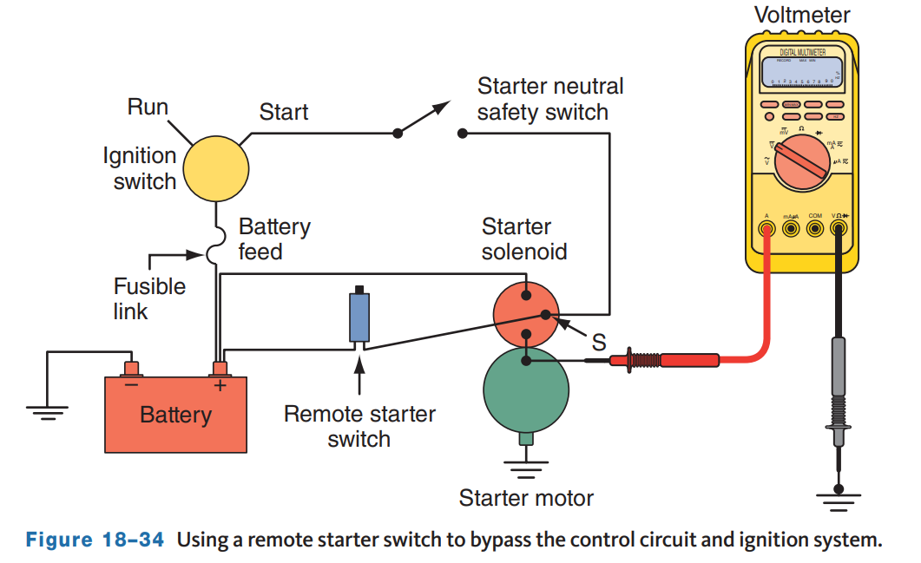
Cranking Voltage Test
The cranking voltage test measures the available voltage to the starter during cranking.
To perform the test, disable the ignition or use a remote starter switch to bypass the ignition switch.
Refer to the service information for specific instructions on the vehicle being tested.
Connect the voltmeter’s negative lead to a good chassis ground.
Connect the positive lead to the starter motor feed at the starter relay or solenoid.
Activate the starter motor and observe the voltage reading. Compare the reading to the specifications. Normally, 9.6 volts is the minimum required.

Slide 30
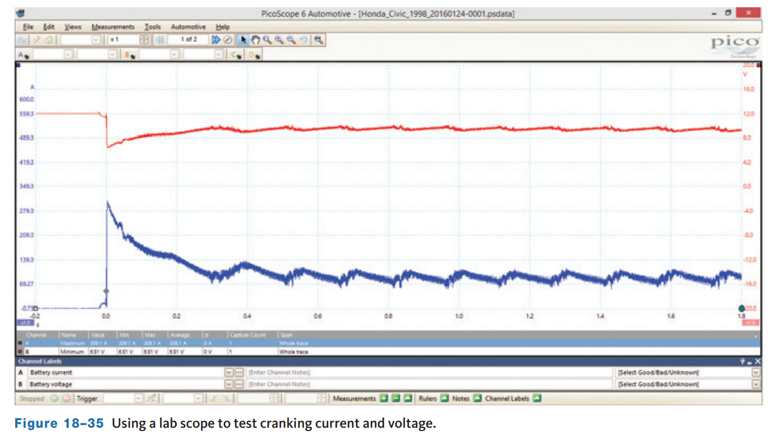
Cranking Current Test
The cranking current test measures the amount of current the starter circuit draws to crank the engine.
This can be done with a VAT-type tester, DMM and current clamp, or a scope with a current clamp to measure the current draw.
Follow the instructions given with the test when connecting the test leads.
Crank the engine for no more than 15 seconds. Observe the voltmeter.
If the voltage drops below 9.6 volts, a problem is indicated.
Also, watch the ammeter and compare the reading to specifications. In general, cranking amperage for gasoline engines will range between 130 and 250 amps depending on engine size.

Slide 31
Insulated Circuit Resistance Test
The insulated circuit includes all of the high-current cables and connections from the battery to the starter motor.
To test the insulated circuit for high resistance, disable the ignition or bypass the ignition switch with a remote starter switch.
Connect the positive (+) lead of the voltmeter to the battery’s positive (+) terminal. Connect the negative (−) lead of the voltmeter to the starter motor or M terminal at the solenoid or relay.
Crank the engine and record the voltmeter reading.
If the voltage drop is within specifications (usually 0.2 to 0.6 volts), the insulated circuit does not have excessive resistance.
Proceed to the ground circuit resistance test.
If the reading indicates a voltage loss above specifications, move the negative lead of the tester progressively closer to the battery, cranking the engine at each test point.
Normally, a voltage drop of 0.1 volt is the maximum allowed across a length of cable.

Slide 32
Ground Circuit Resistance Test
The ground circuit provides the return path to the battery for the current supplied to the starter by the insulated circuit.
This circuit includes the starter-to engine, engine-to-chassis, and chassis-to-battery ground terminal connections.
To test the ground circuit for high resistance, disable the ignition, or bypass the ignition switch with a remote starter switch.
Crank the engine and record the voltmeter reading.
Good results would be less than a 0.2 to 0.6 volt drop for a 12-volt system.
A voltage drop in excess of this indicates the presence of a poor ground circuit connection, resulting from a loose starter motor bolt, a poor battery ground terminal post connector, or a damaged or undersized ground system wire from the battery to the engine block.
Isolate the cause of excessive voltage drop in the same manner as recommended in the insulated circuit resistance test by moving the positive (+) voltmeter lead progressively closer to the battery.

Slide 33
Voltage Drop Test of the Control Circuit
The control circuit test examines all the wiring and components used to control the magnetic switch, whether it is a relay, a solenoid acting as a relay, or a starter solenoid.
High resistance in the solenoid switch circuit reduces current flow through the solenoid windings, which can cause improper functioning of the solenoid.
In some cases of high resistance, it may not function at all.
Improper functioning of the solenoid switch generally results in the burning of the solenoid switch contacts, causing high resistance in the starter motor circuit.
Check the vehicle wiring diagram, if possible, to identify all control circuit components. These normally include the ignition switch, safety switch, the starter solenoid winding, or a separate relay.
To perform the test, disable the ignition and/or fuel system. Connect the positive meter lead to the battery’s positive terminal and the negative meter lead to the starter switch (S) terminal on the solenoid or relay.
Crank the engine and record the voltmeter reading.
Generally, good results would be less than 0.2 volts.

Slide 34
Test Starter Drive Components
This test detects a slipping starter drive without removing the starter from the vehicle.
First, disable the ignition system or bypass the ignition switch with a remote starter switch. Turn the ignition switch to start and hold it in this position for several seconds. Repeat the procedure at least three times to detect an intermittent condition.
If the starter cranks the engine smoothly, that is an indication that the starter drive is functioning properly.
If the engine stops cranking and the starter spins noisily at high speed, the drive is slipping and should be replaced.
If the drive is not slipping, but the engine is not being cranked, inspect the flywheel for missing or damaged teeth.
Remove the starter from the vehicle and check its drive components. Inspect the pinion gear teeth for wear and damage.

Slide 35
Removing the Starter Motor
If your testing indicates that the starter must be removed, the first step is to disconnect the negative cable at the battery and wrap the clamp with electrical tape.
It may be necessary to place the vehicle on a lift to gain access to the starter. Before lifting the vehicle, disconnect all wires, fasteners, and so on that can be reached from under the hood.
Disconnect the wires leading to the solenoid terminals. To avoid confusion when reinstalling the starter, it is wise to mark the wires so they can be reinstalled on their correct terminals.
Loosen the starter mounting bolts and remove all but one. Support the starter while removing the remaining bolt.
Then pull the starter out and away from the flywheel. Once the starter is free, remove the last bolt and the starter.

Slide 36
Installation
When installing a new or remanufactured starter, some technicians will bench test the new starter before installing it back into the car. While not very common, a replacement starter can be defective, and finding out it does not work properly before installing it can save you some time and trouble.
To ensure a good ground path, sand away the paint at the mounting points before installing the starter.
Make sure you have a good hold on the starter while installing it. Tighten the retaining bolts to the specified torque and make sure the starter is fully seated before final tightening.
Make sure that all electrical connections are tight.
Reinstall any heat shields or parts removed during the replacement process.
Some starters use shims between the starter and the mounting pad, and incorrect shimming will result in a high pitched noise when cranking.

Slide 37
Knowledge Check (2 of 2)
If a new starter is installed, and immediately after the starter makes a loud high pitched sound when cranking the engine, what do you expect was done incorrectly?

Slide 38
Knowledge Check Answer (2 of 2)
Some starters require shims between the starter and the mounting pad, and incorrect shimming will result in a high pitched noise when cranking.

Slide 39
Chapter Reflection
Please take a moment to compare your understanding of starting and motor systems. Then respond to the following questions in one or two paragraphs. Use 150–200 words in your reflection.
Did you learn anything new about starting systems in this chapter? What can you do to understand it completely?
Considering all you have learned, do you feel you are able to perform starting and motor system service in the shop?

